Slide 1


Circular Economy
Cibo in circulo
CITIES
Crina Costras
Maia Apetrei
Karina Stanciu
Samuel Cretu

Slide 2
Introduction to Circular Economy
A circular economy is an economic system that tackles global challenges like climate change, biodiversity loss, waste, and pollution by reusing, sharing, repairing, refurbishing, remanufacturing and recycling to create a closed-loop system, minimizing the use of resource inputs and the creation of waste, pollution and carbon emissions. The circular economy aims to keep products, materials, equipment and infrastructure in use for longer, thus improving the productivity of these resources.

Slide 3
In 2015, the European Commission adopted its first circular economy action plan. It included measures to help stimulate Europe's transition towards a circular economy, boost global competitiveness, foster sustainable economic growth and generate new jobs.
The action plan established concrete and ambitious actions, with measures covering the whole life cycle: from production and consumption to waste management and the market for secondary raw materials and a revised legislative proposal on waste.

Slide 4
Circular Economy in Cities
Building a circular economy in cities can bring tremendous economic, social, and environmental benefits. If we can reduce congestion, eliminate waste, and bring down costs, higher economic productivity and new growth will allow cities to thrive. New business opportunities will support skills development and jobs.
Cities are the engine room of the circular economy, where government, business and citizens co-exist at a scale to enable powerful collaboration and partnerships.

Slide 5
By 2050, cities will be home to two thirds of the population, consume 75% of the world’s natural resources, produce 50% of global waste and over 60% of greenhouse gas emissions. As this collection of cases shows, cities all around the world are in a prime position to help scale-up the circular economy transition in a wide variety of ways.

Slide 6
WHAT DOES A CIRCULAR ECONOMY BRING TO CITIES?
The need for change is increasingly evident, with cities feeling the effects.The circular economy offers an opportunity to respond to these challenges byrethinking how we use materials, leading to wholly new ways of creating value.

Slide 7
The implementation of a circular economy vision in cities can bring tremendous economic, social, and environmental benefits. It can foster the emergence of a:
Thriving city in which economic productivity increases through reduced con stion, eliminated waste, and reduced costs, and where newgrowth and business opportunities can support skills development andjobs,
Liveable city with improved air quality and urban health, reduced carbon emissions and pollution, and with enhanced social interactions,
Resilient city, keeping materials in use and reducing virgin material pressures, working with both local and distributed production capacity, and harnessing digital technology

Slide 8
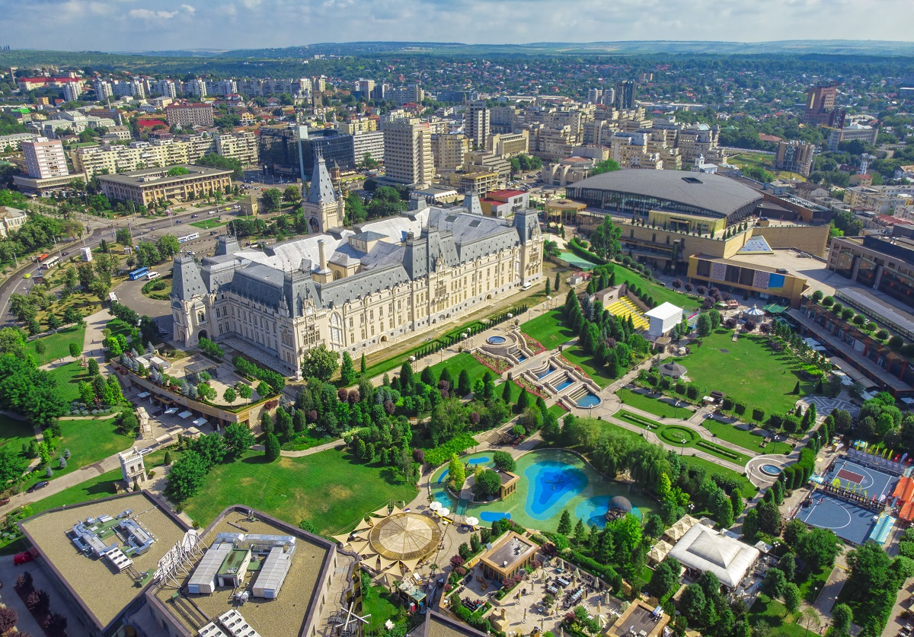
Romania. Iasi
In Romania many cities took initiative in turning the economy circular. In most markets biobased and compostable packaging is a must and recycling correctly is being normalized day by day. Iasi is the first city in Romania to take initiative and change their economy system. In Iași a project that is evolving every day is the Solid Waste Management for Circular Economy. This project is all about recycling the corect way and encouraging people to make a change for a better outcome.

Slide 9
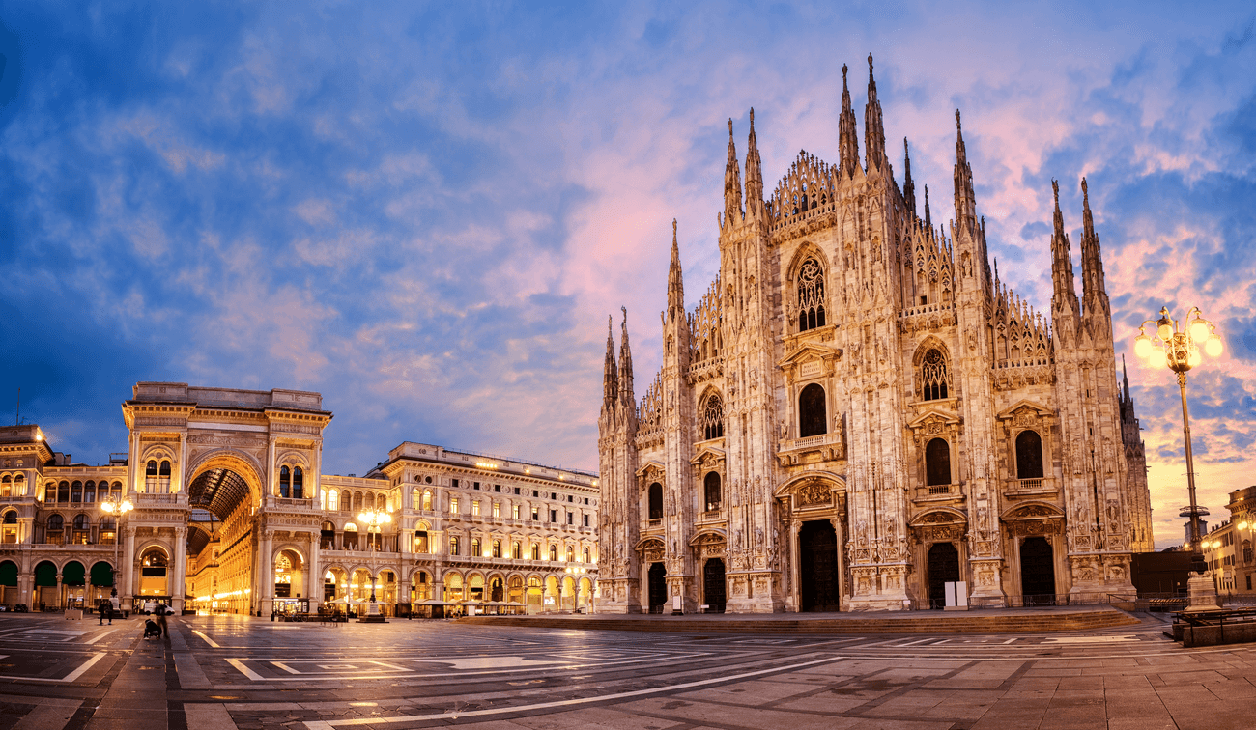
Italy. Milan
Since the launch, many concrete initiatives have been developed and implemented that build on the foundation of the Milan Food Policy.
The first step was to assess the local food system by engaging food experts and stakeholders. A public consultation was launched, involving city departments, universities, businesses, and other organisations, which collaborated to establish the most effective strategy,.

Slide 10
Comparison
Romania is barely in the beginning of implementing the ideas of circular economy compared to Italy who has started a long time ago to adopt the circular economy vision. In conclusion, the idea of circular economy is new and a work in progress.

